Slide 1
Construction Studies

Slide 2
Theory
The Syllabus
In place since 1984
Extensive
Presented as areas of content
Study of contemporary practices
New syllabus developed by 2002 – implementation deferred

Slide 3
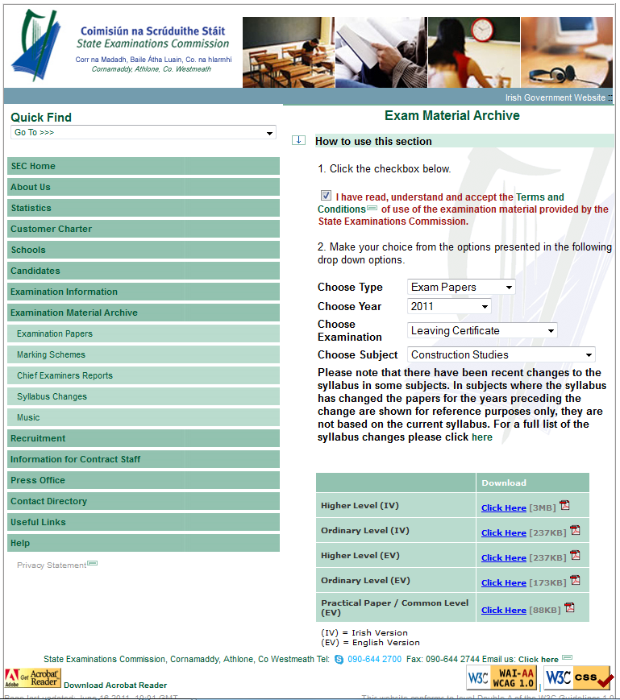
Sources of Information
The Syllabus:
http://education.ie/en/Schools-Colleges/Information/Curriculum-and-Syllabus/Senior-Cycle-/Syllabuses-and-Guidelines/lc_construction_studies.pdf
Past Examination Papers:
Marking Schemes:
Extensive detailing of possible answers with marks
Chief Examiner’s Reports:
Last published in 2009
Notes:
So why

Slide 4
Sources of Information
Useful resources:
Web:
Technical Guidance Documents - Environ.ie, NDA.ie, EPA.ie, local authorities, Passive house plus.ie, Heritagecouncil.ie, t4.ie,Technoteachers.ie
Print:
HomeBond House Building Manual

Slide 5
Chief Ex. Comments
It is recommended that teachers:
• ensure that an adequate balance is achieved between the theoretical, practical and coursework components of the course
• emphasise the importance of high quality sketches as a means of communicating architectural detailing and encourage students to keep a sketchbook for regular practice of sketching.
It is recommended that students:
• read the questions carefully so as to ensure that they respond to what is being sought in the question
• pay more attention to the development of freehand sketching techniques to enable them to convey information using high quality freehand sketches
• be mindful that the written examination comprises 50% of the total marks for the subject and that they plan their time to ensure that they spend adequate time studying for the written examination

Slide 6
Assessment
Key Points:
Answers should:
reflect current Building Regulations
be consistent with current practice
Students should:
plan the use of their time
be mindful that the last section in questions provides the least marks
read questions very carefully
provide notes and sketches where both are requested
pay particular attention to the quality of sketches

Slide 7
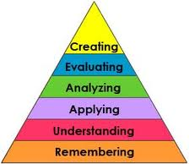
Strategy for Teaching
Evolution of assessment
How to How could
Remembering knowledge Understanding Knowledge
Applying
Blooms Taxonomy (Anderson, & Krathwohl, 2001)

Slide 8
Strategy for Teaching
Factors:
Timetable and Facilities
Resources and Budget
Extensive syllabus
- Scale drawing
- Sketching
Student ability and application
Maintaining student engagement
Higher & Ordinary levels
Available time
Assessment requirements
Literacy & Numeracy
No fixed approach !
Notes:
Group Activity and Feedback

Slide 9
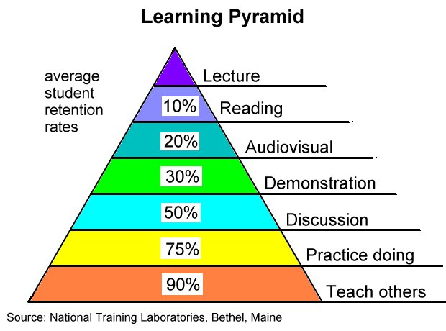
Teaching Methodologies
Death by PowerPoint !
Student engagement and learning
How do we facilitate learning?

Slide 10
Active Teaching
Active Teaching Methods in School
Group projects Questionnaires School library Computer research Collage Practical work Periodicals Experimentation Class feedback Other staff members Individual interview Brainstorming Group discussion Case studies Sharing your own experiences Group work Role play Individual students – class presentation Visitor Posters/brochures Vox pop Using the video Enterprise Performance Diary keeping Exhibition
What do I use?
Notes:
Distribute Active Methodologies Survey sheet. Each individual teacher completes.

Slide 11
Active Teaching
Task:
How could I teach this topic in a new way using Active Methodologies?
The Planning Process
Electricity
Universal Design
External walls
Stairs
Dwelling Layout
Notes:
Participants broken to groups of five for 10 min. Each group asked to address two of the topics listed on the slide and develop an active methodology to teach a significant aspect of the topic. Distribute Active Methodology Planning Sheet

Slide 12
Active Teaching
Feedback
and
Discussion

